Slide 1
Rewriting the Script
Success doesn’t wear a lab coat

Slide 2
Content
I
w
H
W
Introduction
WHO
How
what

Slide 3
Introduction
1

Slide 4

Can your academic path truly limit who you become?
Is medical school a path—or a prison?
We can dream beyond the walls of medicine—and thrive in more than one path. Today’s character is living proof of that truth.
So, let us introduce

Slide 5

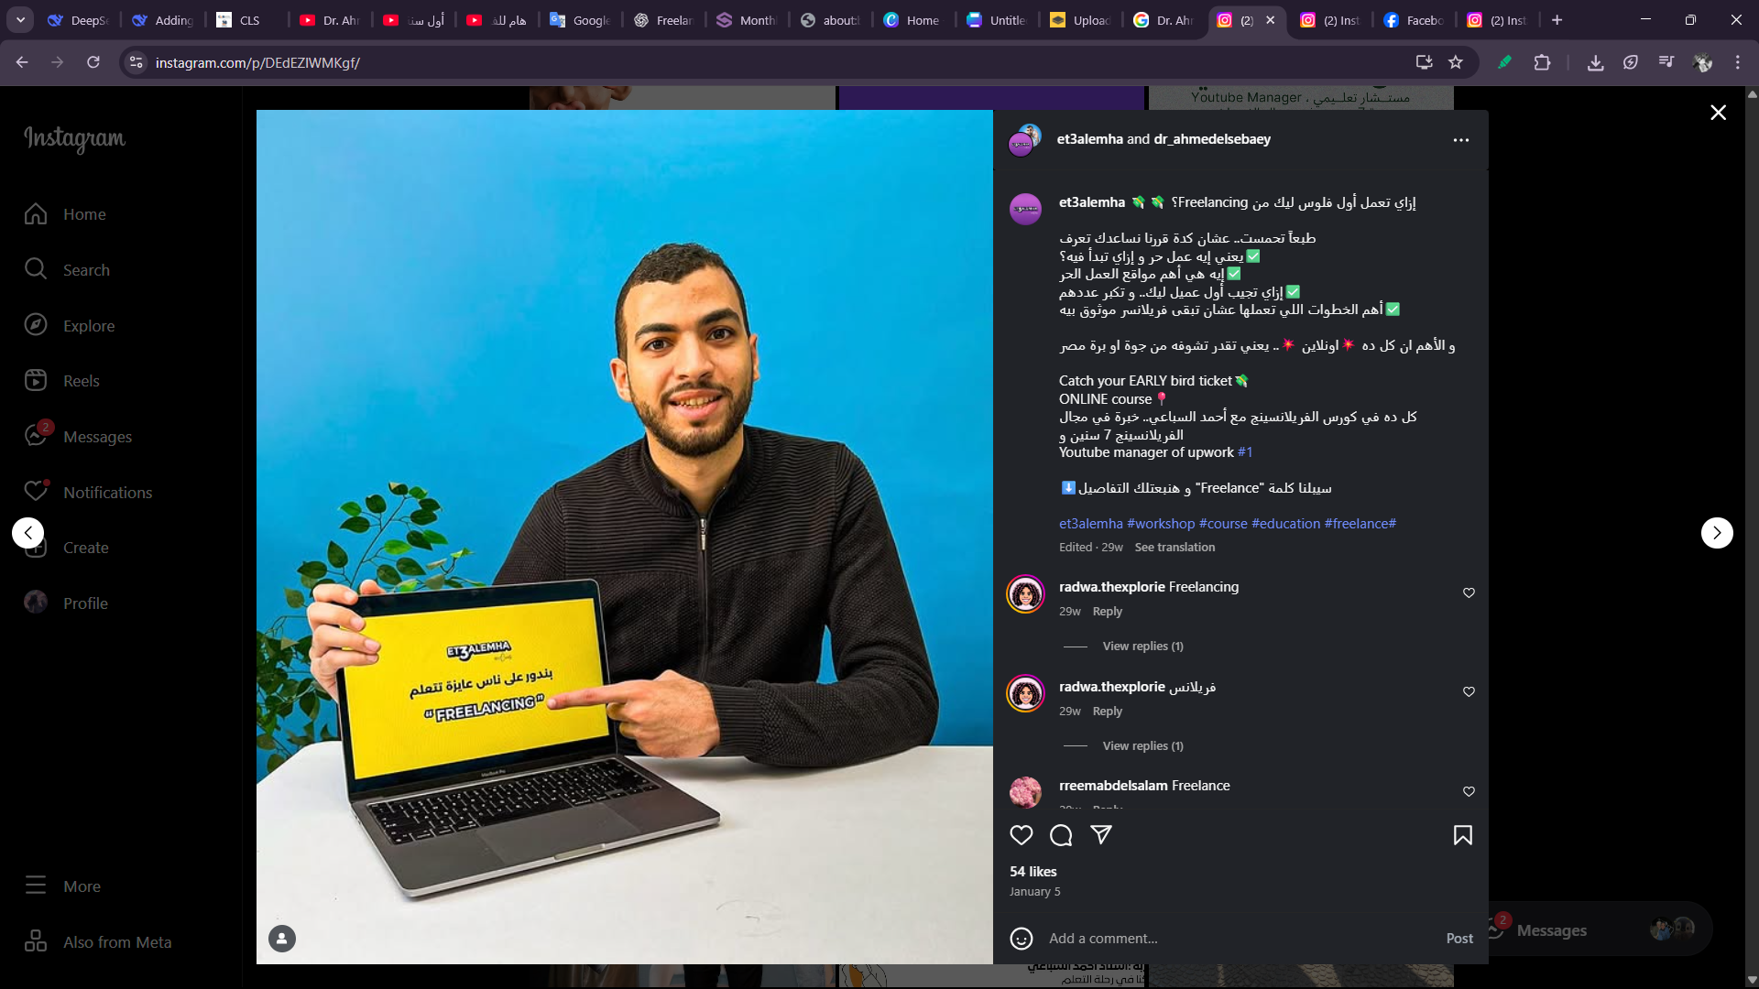
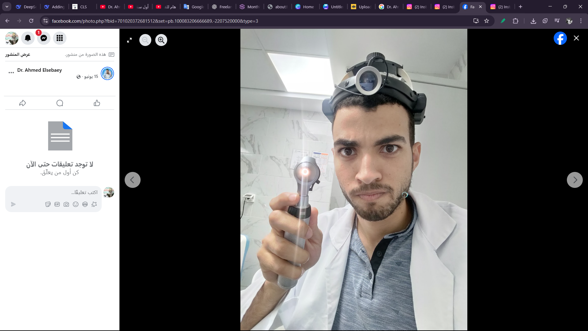
Dr. Ahmed Elsebaey

Slide 6
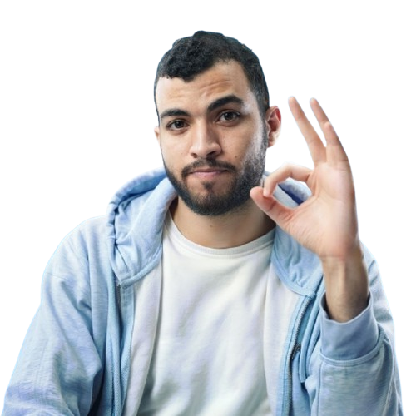
Who is Dr. Ahmed Elsebaey?
2

Slide 7
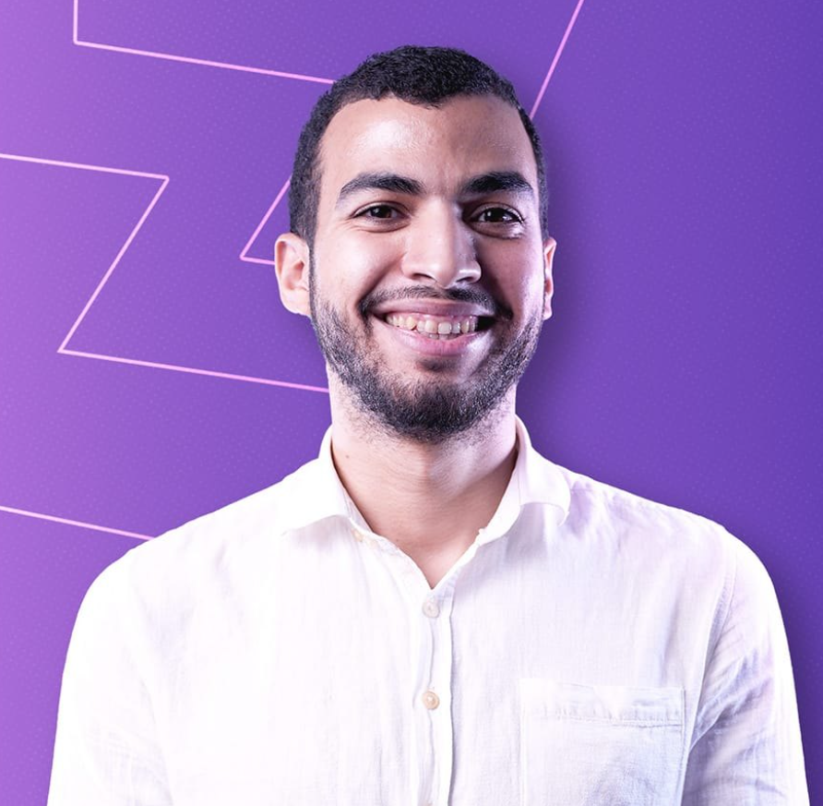
Dr. Ahmed El‑Sebaey is an Egyptian freelancer and the founder of the Freelanzwya platform.
He is also a medical doctor who graduated from Kasr Al Ainy Faculty of Medicine, Cairo University. Despite his medical background

Slide 8
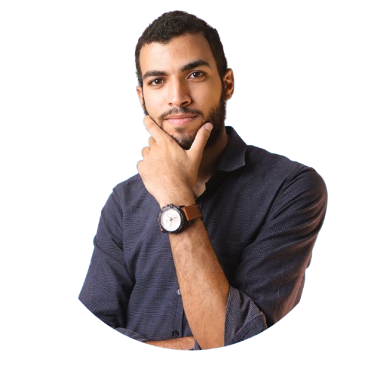
How did he start?
3

Slide 9

His story is a reminder that one moment — if you're brave enough — can change your whole life.
He used to watch a YouTube channel called "Talk Islam", and one video by Ibrahim Saleh about the meaning of life deeply moved him. That moment sparked a dream — to start a channel of his own.
So, he began by designing a logo. While searching online, he came across Fiverr — and that discovery became the turning point that launched him into the freelancing world.

Slide 10
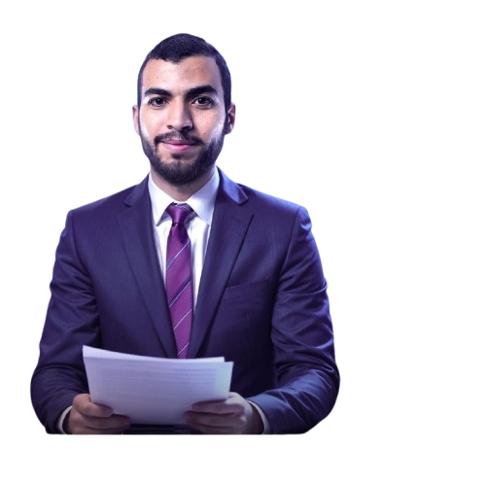
What are his Achievements?
4

Slide 11
💼 Freelance Career Highlights
Started working in the fields of motion graphics and social media management on Fiverr and Upwork.
Successfully delivered hundreds of projects to over 500 clients worldwide.
Became a Top Rated Freelancer on Upwork, especially in YouTube Channel Management, with more than 2,300 hours of verified work.
Ranked as the #1 freelancer in Egypt and among the top 3 in the Arab world in his field.

Slide 12
🚀 Freelanzwya Platform
In March 2023, he launched Freelanzwya.com — the first Arabic platform fully dedicated to teaching freelancing in a structured and practical way.
The platform offers:A free 8-week roadmap to get started with freelancing.
Advanced courses in YouTube channel management, Notion mastery, and more.
A growing blog with professional advice, tools, and real-world tips.

Slide 13
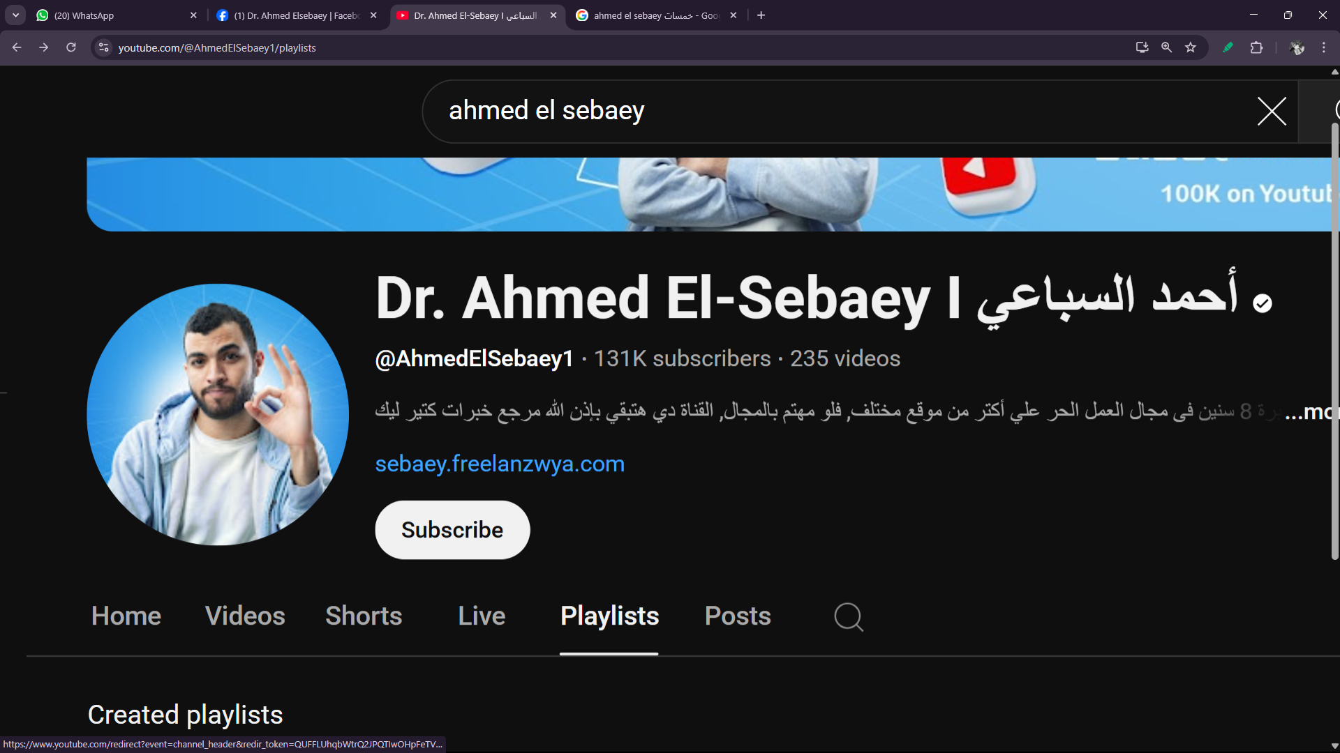
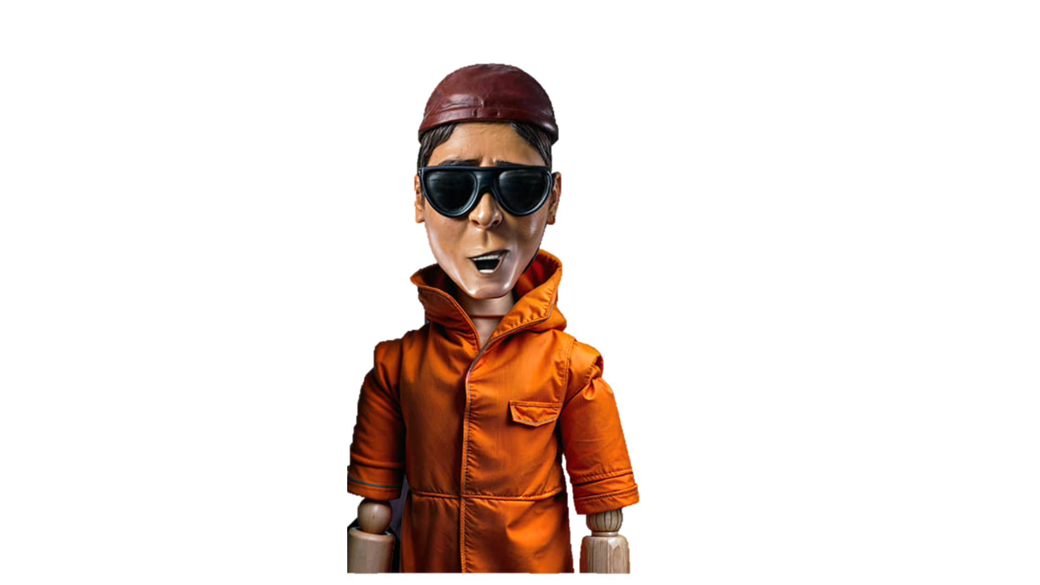
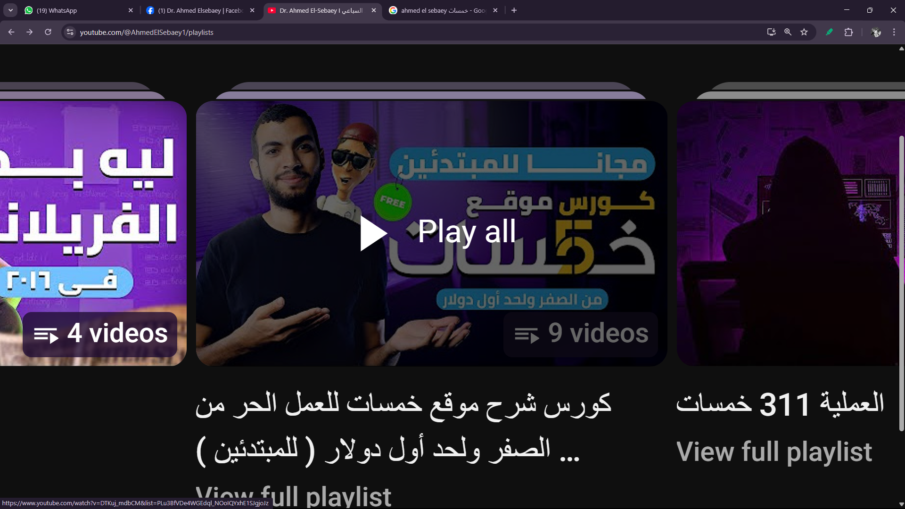
احنا صحاب البلد

Slide 14


